Slide 1
The Ethics of Data Visualization

Slide 2
The ethical responsibilities of a data scientist are present in every step of the workflow of a particular data set.
For example, during data analysis several questions may arise: Should I delete this entry during data clean-up? Does my analysis unfairly bias a certain group?
The delivery and presentation of results, most particularly through data visualization is a step where a data scientist may behave unethically without even realizing it.

Slide 3
There are two main ways a figure with accurate data could delude a viewer by delivering a an exaggerated/understated message or by communicating the reverse of the message contained in the data.

Slide 4
common ways a visualization can exaggerate or understate:
Truncated axes: has a y axis that does not start at 0. These graphs can create the impression of important change where there is relatively little change.
Aspect ratio (particularly true for line graphs)
Portraying quantity in less than obvious ways (e.g. using the radius vs. area of a circle in a bubble plot)

Slide 5
Examples of bad visualizations

Slide 6
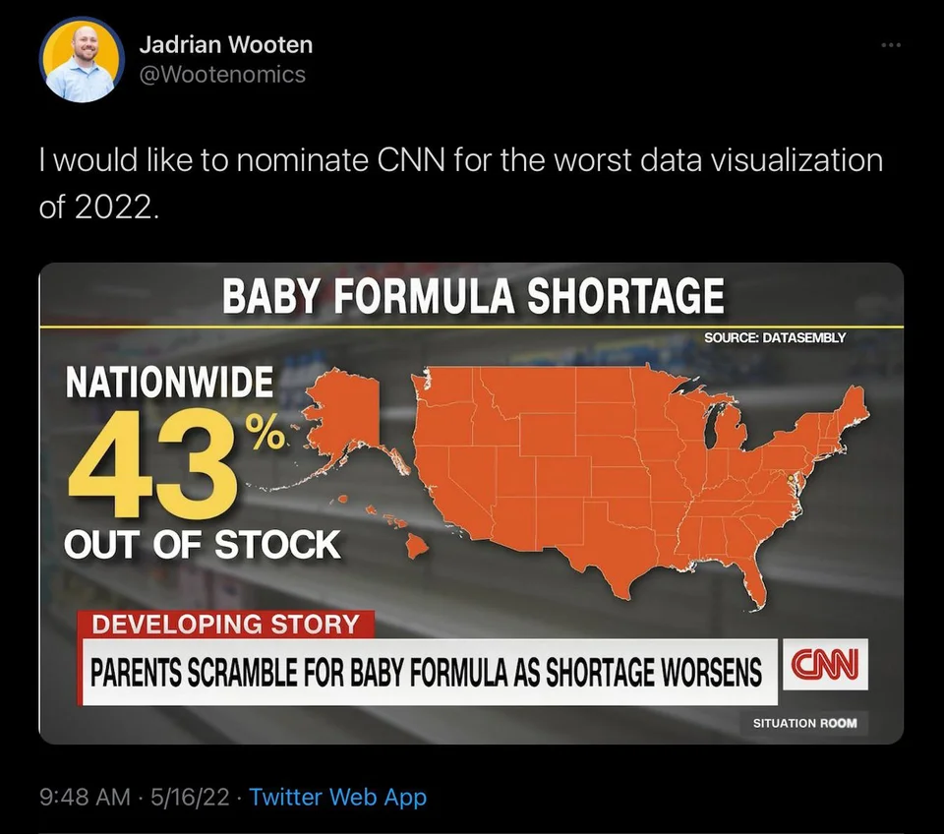
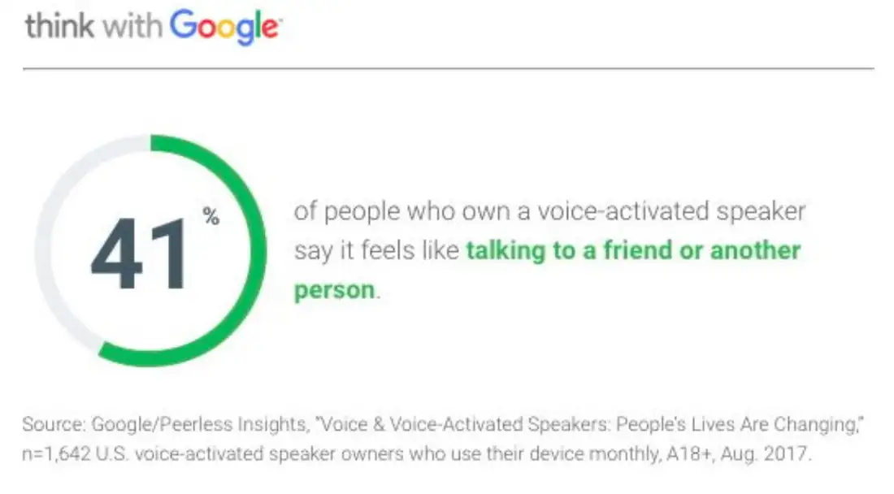
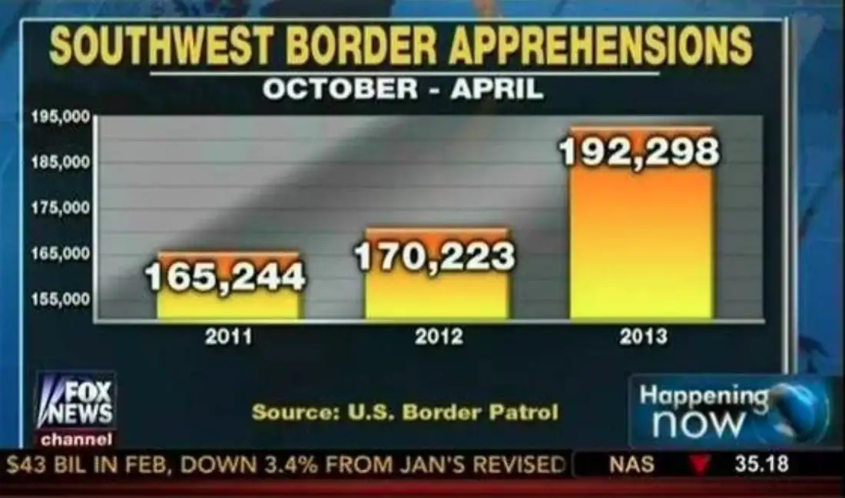

Slide 7
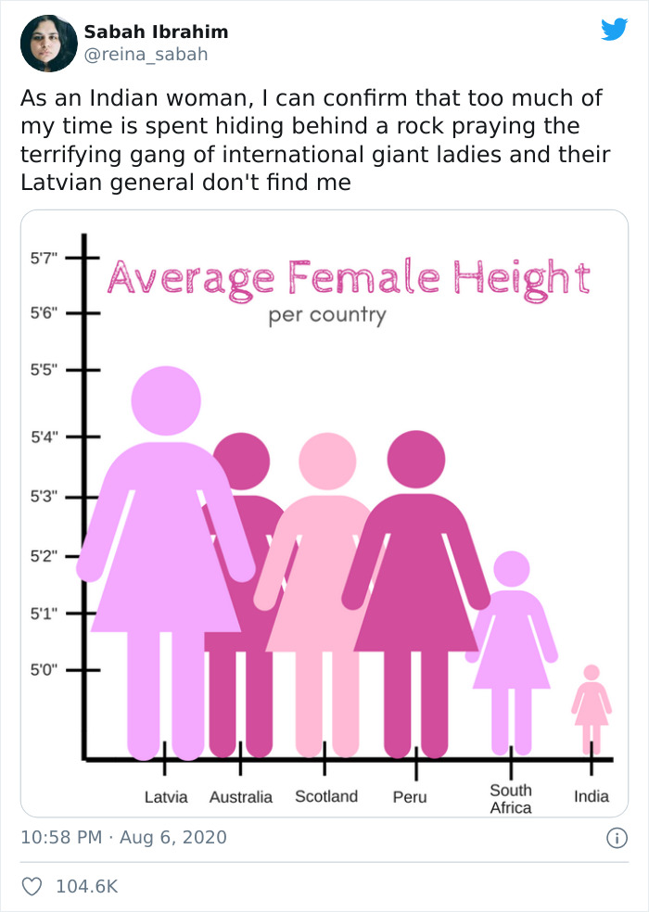


Slide 8
Class Activity:
What is the issue with the following graphs?

Slide 9
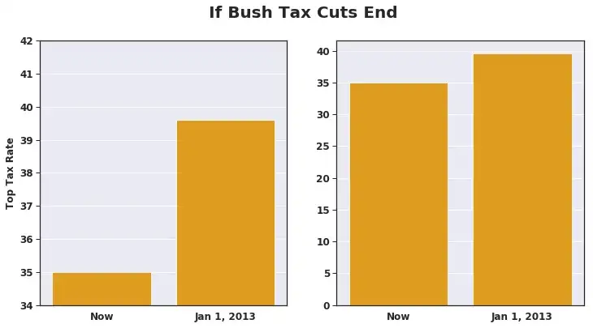

Slide 10
Example of truncated axis deception. Replica of graph shown on major news network.

Slide 11
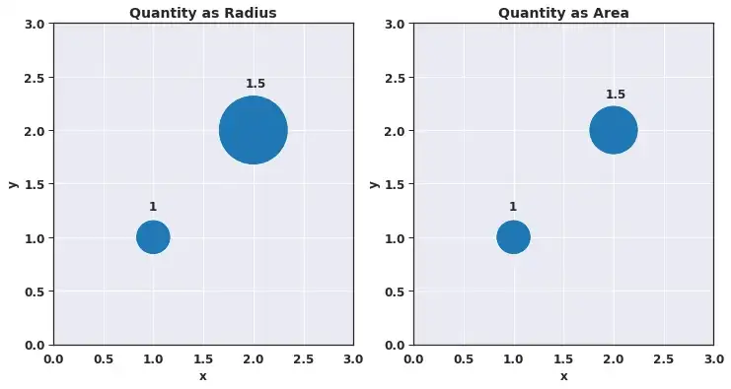

Slide 12
By using the radius over the area, the perceived difference in values is much larger than in the data.

Slide 13
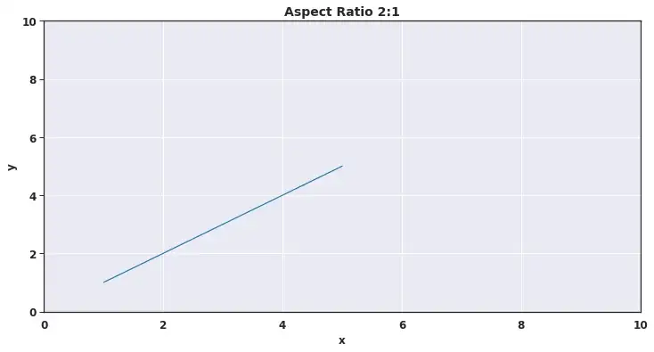

Slide 14
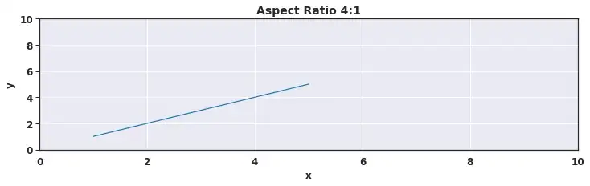
Notice that the slope is in fact the same although the angle of the graphs may be different.

Slide 15
All of these deception techniques actually influence the viewer’s views of the message.
This has been shown by an empirical study performed by Pandey, et al (2015).

